Slide 1
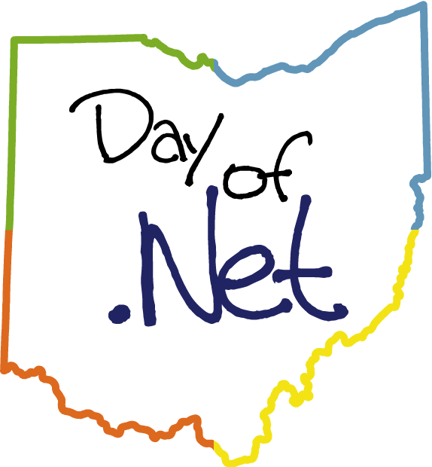



Central Ohio Day of .NET
2008
Hosted By:

Slide 2
Open Spaces
No slides, no code, no gear (unless you want)
Converse with other geeks about anything
Propose a topic on the Open Spaces board in the foyer
Mark sessions you’re interested in with a hash
Check later to find when the session meets
Show up!
Vote with your feet if it’s not of value to you
Open Spaces in the Liberty Room after Lunch
Got questions? Ask a staff member

Slide 3














Thanks to our Sponsors!

Slide 4
Getting Started with ASP.Net MVC
Tim Wingfield
Notes:
Preview 2 came out in march.
New preview code drop came out on Thursday (4/17)

Slide 5


What’s the problem?
!=
Notes:
“What are we trying to solve? What’s wrong with WebForms?”
WebForms tried to move WinForms to web development
Introduced page event model
Some developers think this is the way the whole web works

Slide 6
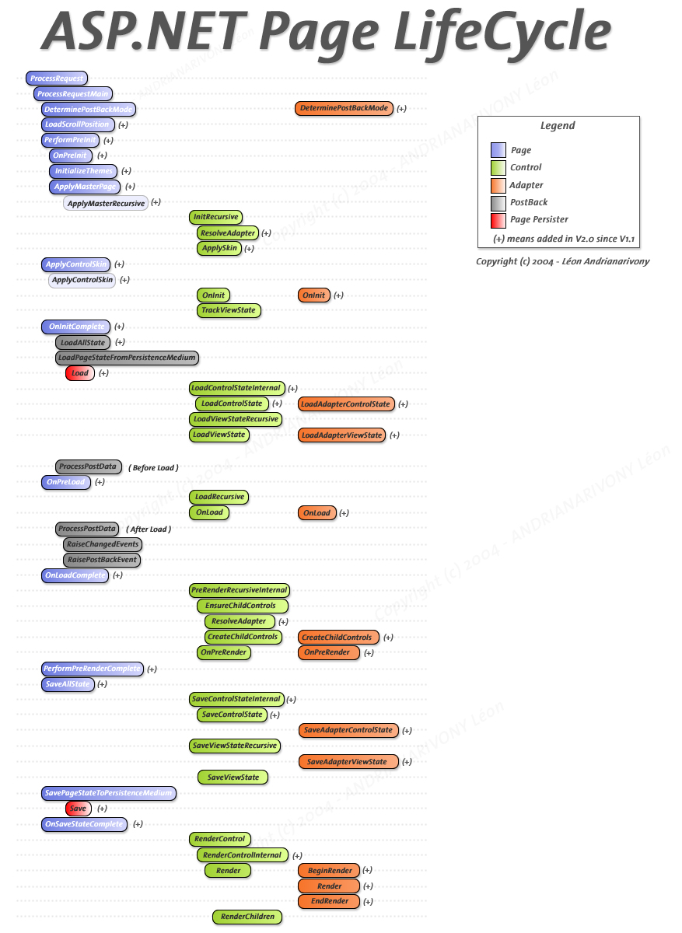
Notes:
Who doesn’t love this?
Was that OnPreInit or OnPreLoad?
Page Lifecycle brings state to the web, not totally a bad thing, but we all know the web is stateless
Runat=server
Naming Container in javascript <% %> all over the place

Slide 7
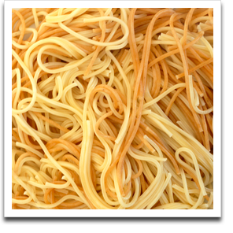
Page_Load(object sender, EventArgs e) { }
Notes:
The spaghetti of the page_load. (A steaming pile of Page_Load)
Neal Ford: “Bad developer will move heaven and Earth to do the wrong thing.”
Mix of presentation and logic in the code behind, no Separation of Concerns
Extremely difficult to test code behinds
Dependent on web server to run
Concrete classes on the web server run WebForms
No way to fake or mock those classes

Slide 8















Peer pressure
Notes:
Everybody’s doing it, man
PHP lists 35 different MVC implementations on Wikipedia
Explain why monorail is a valid alternative, but it’s Open Source (Built on WebForms)
Demand from community for an offering from Microsoft

Slide 9
Model
View
Controller
Notes:
Obligatory 3 circle diagram
Request comes in from one of the Internets
Controller handles request
Determines view
View indirectly determines if it needs information from the Model (asp.net version, view can be strongly typed to the model)
Model returns information as requested, doesn’t know to what view or what controller has called
Model everything that’s not view and controller – business logic, data
Response is returned back to the Internets

Slide 10
Why ASP.Net MVC
New offering for ASP.Net from Microsoft
Alternative to WebForms
Routing
Release 2 applies to WebForms
RESTFUL
Notes:
Proven Pattern – 1979 in Smalltalk
Expand on not a replacement to WebForms
- Alternative to WebForms
- WebForms not going away
- Not WebForms 4.0
Routing
Maps incoming URLs to the correct Controllers
Maps outgoing URLs so the can be called back
Originally part of mvc namespace, has been moved “up” to web namespace
RESTFUL – uses get and post out of the box (Adam Tybor’s blog post)

Slide 11

Increased testability
Notes:
Encourage use of OOP principles
Separation of Concerns
Single Responsibilty
Dependencies are abstracted out to HttpContextBase, HttpRequestBase, etc
All Http classes now easily mocked or faked (MVC Mock Helpers)

Slide 12
More control over your HTML
Runat=“server”
Notes:
Bye bye naming container
No more control.ClientId
Separation of concerns, keep business logic out of your presentation code
Use of CSS easier

Slide 13
Request and Response
Request
Response
Notes:
Back to Requset and Response
Request comes in
Controller interprets the request and decides what to do
Application does something cool
Response is sent back to the Internets
No Postback
Page lifecycle still happens (look at trace)
Still based on asp.net

Slide 14

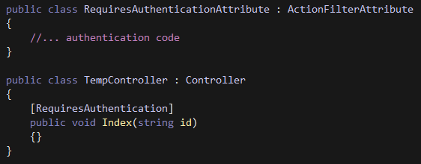
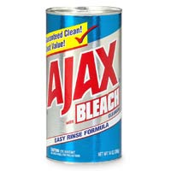
Customizable and Extensible
Notes:
Custom Routing
Filter Attribute
Add Ajax

Slide 15
You have options
<a href=“/Product/View/12”>
View Product
</a>
<%= Html.ActionLink(“View Product”,
“View”,
new { id=12} ) %>
<%= Html.ActionLink<Product>
(c => c.View(12), “View Product”) %>
Notes:
Quick and dirty, plain old html. Id replaced by classic asp-ish code
Will work, but magic strings everywhere
If your controller changes, refactoring here will be uncovered at runtime
Better way, as controller is implied. (Unless needed to move to a different controller)
Controller changes will again be uncovered at runtime.
Best way, the view is strongly typed to the controller.
Controller change here will break the build…woo-hoo! Fail early!

Slide 16
MvcContrib.org
IoC container controller factories
View Helpers
Code Snippets and Live Templates
Notes:
Open source project on CodePlex
Adding code for MVC to work with Castle, Spring.Net, Structure Map, etc.
Original HtmlHelpers folded into release 2, MvcContrib picking up where they left off
Add on code for VS and for R#

Slide 17
Model
MyMvcAppTests
Default Routes
View
Controller
WebFormsViewEngine
Notes:
What do you get out of the box?
Working Sample App
Default Routing
Home Controller
Home and About Views
WebFormsViewEngine
Test Project
What’s Going on?
Browser makes request (use Products)
Route is determined
Controller Activated
Gets data from Model
Determines View
Renders View

Slide 18
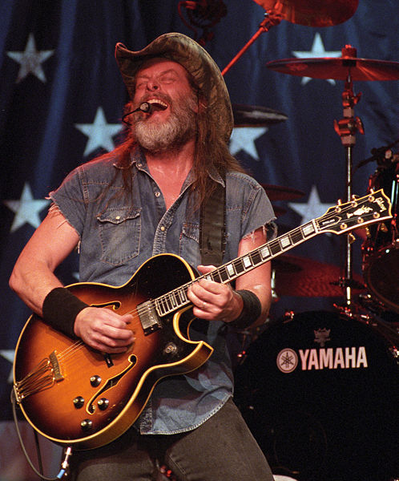
Web Forms are Dead!
Long Live Web Forms!
Notes:
Still going to fit larger, data driven sites better. (At least for now.)
Much more mature framework to build ASP.Net apps on
Quicker deployment, more drag and drop
More Better UI controls available.
Lots of 3rd party controls available…like our Friends at Telerik
Better Documentation
More examples and code samples to draw from
And, of course, the update panel!

Slide 19
<code />
Notes:
New app
Demo app

Slide 20
Resources
www.asp.net/learn/3.5-extensions-videos/
www.hanselman.com/blog/
www.haacked.com
sessions.visitmix.com/?selectedSearch=T22
weblogs.asp.net/scottgu/

Slide 21
Tim Wingfield email: tim@timwingfield.com blog: blog.timwingfield.com twitter: timwingfield

